Slide 1



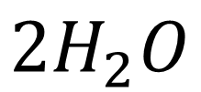





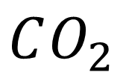




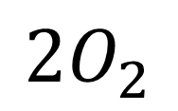

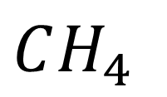




H
H
C
C
C
H
H
+
=
C
C
+
O
H
H
H
C
C
C
H
$$CH_{4}$$
+
$$2O_{2}$$
=
$$CO_{2}$$
+
$$2H_{2}O$$

